Slide 1
Introduction to Artificial Intelligence
(40-417)
Instructor: Masood Feyzbakhsh

Slide 2
Course Page
To be created
  Announcements
  Slides
  Assignments

Slide 3
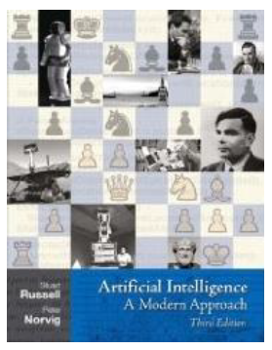
Textbooks
S Russell and P Norvig, Artificial Intelligence: A Modern Approach, Prentice Hall, 3rd ed., 2010.

Slide 4
Evaluation
Quizzes and Assignments (10%)
Project (20%)
Mid-Term Exam (35%)
Final Exam (35%)

Slide 5
What is Artificial Intelligence (AI)?
Views of AI fall into four categories in Two dimensions:
  Thinking/Reasoning vs. behavior/action
  Success according to human standards vs. success according to an ideal concept of intelligence (rationality):
The textbook advocates "acting rationally"
Act like humans | Act rationally
Think like humans | Think rationally

Slide 6



Acting Humanly - Turing test
AI system
Experimenter
Control

Slide 7
Acting Humanly - Turing test
To act humanly a system needs
  Natural language processing
  Knowledge representation
  Learning
  Automated Reasoning
  Vision and speech recognition (total Turing test)
  Robotics (total Turing test)
Problems
  Not reproducible
  Not constructive
  Not amenable to mathematical analysis

Slide 8
Thinking Humanly – Cognitive Modeling
Cognitive Science
  Scientific analysis of activities of the brain
We need to get inside the actual workings of human minds
  Observing the electrical behavior of the brain
  Brain imaging
  Introspection: trying to catch our own thoughts as the go by
  psychological experiments: observing a person in action
Cognitive Science and AI are now two separate fields

Slide 9
Thinking rationally: “laws of thought”
The Greek philosopher Aristotle was one of the first to attempt to codify “right thinking,”
  Socrates is a man; all men are mortal; therefore, Socrates is mortal.
By 1965, programs existed that could, in principle, solve any solvable problem described in logical notation
There are two main obstacles to this approach
  First, it is not easy to take informal knowledge and state it in the formal terms
  Even problems with just a few hundred facts can exhaust the computational resources of any computer

Slide 10
Acting rationally: The rational agent
A rational agent is one that acts so as to achieve the best outcome or, when there is uncertainty, the best expected outcome.
Two advantages over the other approaches
  It is more general than the “laws of thought” approach
    Inference is just one of several possible mechanisms for achieving rationality well defined
  It is more scientific compared to approaches based on human behavior or human thought.
    Standard of rationality is mathematically well defined
Bounded rationality design best agent for given resources
We will focus on rational agents in this course

Slide 11
Acting Rationally
Rational behavior: doing the right thing
“The right thing”:
  is expected to maximize goal achievement, given the available information
  Limited resource, imperfect knowledge
Doesn't necessarily (but often) involve thinking
Doesn’t necessarily have anything to do with how humans solve the same problem.

Slide 12
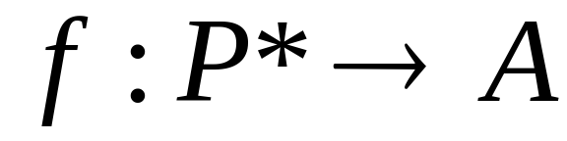
Rational agents
An agent is an entity that perceives and acts
The text book focuses on designing rational agents
  An agent is a function from percept histories to actions:
  For any given class of environments and task, we seek the agent with the best performance.

Slide 13
The Origins of AI
1950 Alan Turing’s paper, Computing Machinery and Intelligence, described what is now called “The Turing Test”.
Turing predicted that in about fifty years "an average interrogator will not have more than a 70 percent chance of making the right identification after five minutes of questioning".
1957 Newell and Simon predicted that "Within ten years a computer will be the world's chess champion."

Slide 14
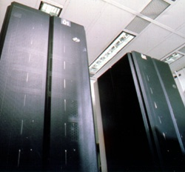
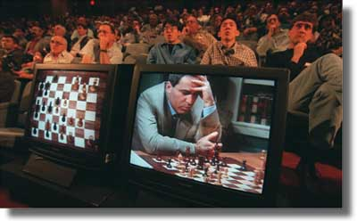
Newell and Simon Prediction
In 1997, Deep Blue beat Gary Kasparov.

Slide 15
But Chess is Easy
The rules are simple enough to fit on one page
The branching factor is only 35.

Slide 16
A Harder One
John saw a boy and a girl with a red wagon with one blue and one white wheel dragging on the ground under a tree with huge branches.
Notes:
Parses: read bottom up. It gets worse at the end. 8064 total.
With huge branches: tree, ground, dragging, wheel, wagon, girl, boy and girl, saw (8)
under a tree can attach to ground, dragging, wheel, wagon, girl, boy and girl, saw. (7)
On the ground (6)
Dragging: wheel, wagon, girl, boy and girl (4)
And: (one blue and one white) wheel, one blue and (one white wheel) (2)
With a red wagon: girl, boy and girl, saw (3)
How hard to check each?
Current approaches: use statistics to guess right a lot of the time. But note that this one is ambiguous even for people.

Slide 17
How Bad is the Ambiguity?
Kim (1)
Kim and Sue (1)
Kim and Sue or Lee (2)
Kim and Sue or Lee and Ann (5)
Kim and Sue or Lee and Ann or Jon (14)
Kim and Sue or Lee and Ann or Jon and Joe (42)
Kim and Sue or Lee and Ann or Jon and Joe or Zak (132)
Kim and Sue or Lee and Ann or Jon and Joe or Zak and Mel (469)
Kim and Sue or Lee and Ann or Jon and Joe or Zak and Mel or Guy (1430)
Kim and Sue or Lee and Ann or Jon and Joe or Zak and Mel or Guy and Jan (4862)

